Slide 1
Face Recognition Attendance System using Image Processing

Slide 2
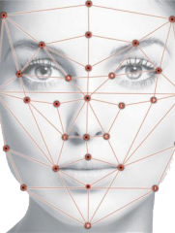
PresentationContent
Introduction
Face detection
Posing and projecting faces
Encoding faces
Face recognition
Part of code

Slide 3
Introduction
A facial recognition system is a technology capable of matching a human face from a digital image or a video frame against a database of faces, typically employed to authenticate users through ID verification services, works by pinpointing and measuring facial features from a given image.
While initially a form of computer application, facial recognition systems have seen wider uses in recent times on smartphones and in other forms of technology, such as robotics. Because computerized facial recognition involves the measurement of a human's physiological characteristics facial recognition systems are categorized as biometrics.
Face recognition mainly depend on AI and deep learning and we will apply this technology to install attendance system in collages

Slide 4
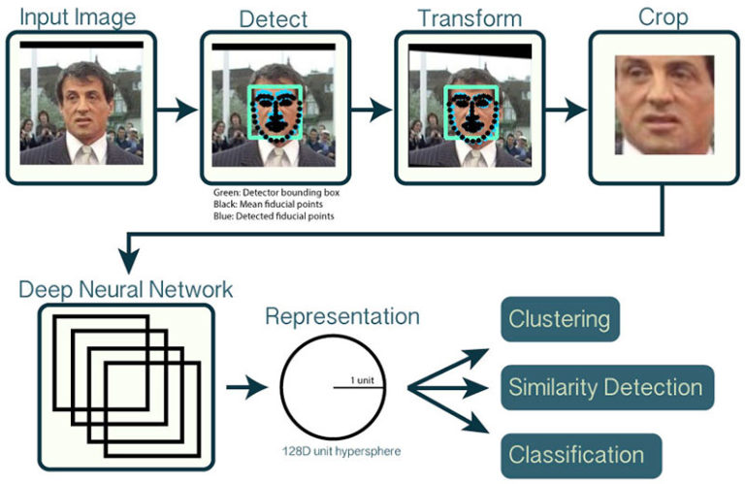
Introduction

Slide 5
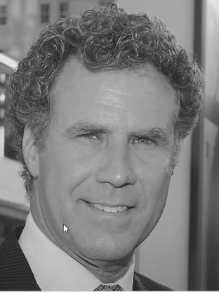
Face detection
face detection went mainstream in the early 2000’s when Poul viola and Micheal Jones invented a method in 2005 called histogram of oriented gradients (HOG)
To find faces in the images, we will start by making our image black and white because we don’t need color data to find faces

Slide 6
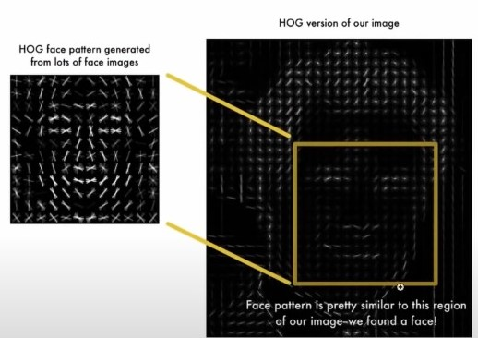
The method is to break up the images into small squares of 16x16 pixels each. Then calculate how many gradients point in each major directions (up , up right , right , etc…) ,then replace the square in the image with strongest arrow direction
The algorithm find the part of the image that looks the most similar to a known HOG pattern that was extracted from other training faces

Slide 7
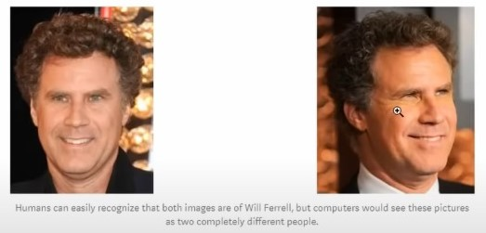
Posing and projecting faces
To deal with the problem of turned faces we use an algorithm called face landmark estimation , provided by the dlib library

Slide 8
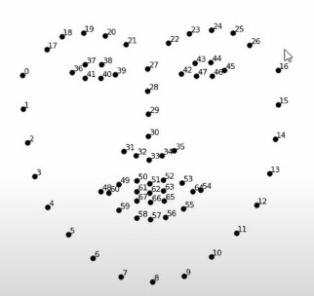
Posing and projecting faces
The basic idea is we well come up with 68 specific points (called landmarks) that exist on every face, the top of the chin , the outside edge of each eye , the inner edge of each eyebrow.
Then we will train a machine learning algorithm to be able to find these 68 specific points on any face:

Slide 9
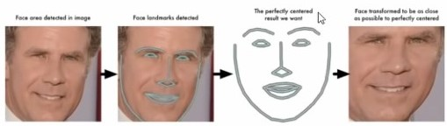
Posing &projecting faces
Now no matter how the face is turned , we are able to center the eyes and mouth are in roughly the same position in the image. This will make our next step a lot more accurate

Slide 10
Encoding faces
It is a face for us. But, for our algorithm, it is only an array of RGB values. For face recognition, the algorithm notes certain important measurements on the face like the color and size and slant of eyes, the gap between eyebrows, etc. All these translated to 128 measurements by running the input image through the trained neural network

Slide 11
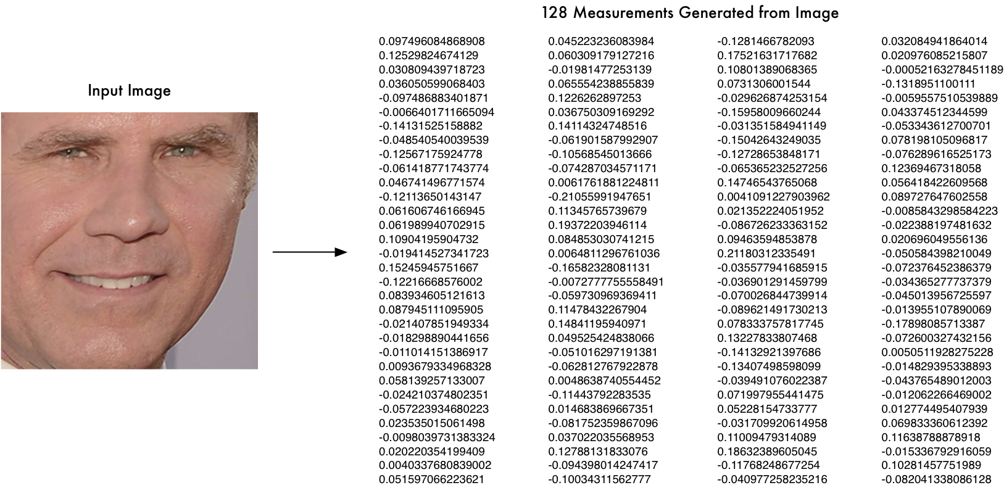
Encoding faces

Slide 12
Face recognition
After we encoded all the images in system , we do the same processes(face detection , face landmark estimation and face encoding) to the images(frames) captured by the video cam
Then compare the encodings and if there is a match we save the name of the student with his arrival time and date in the attendance excel sheet

Slide 13
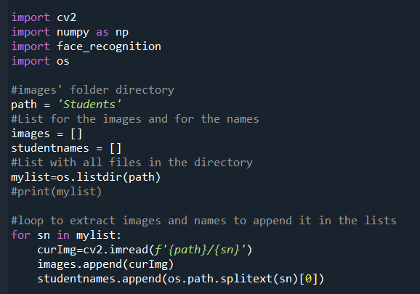
Code documentation
From the directory we get list of images and names of student in our systems

Slide 14
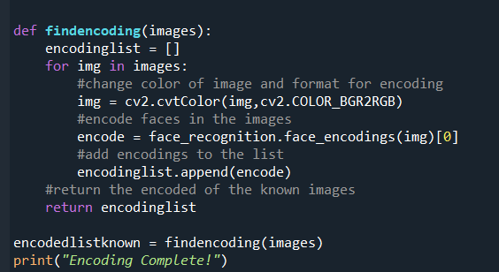
Code documentation
Transform the list of images into a list of their encodings

Slide 15
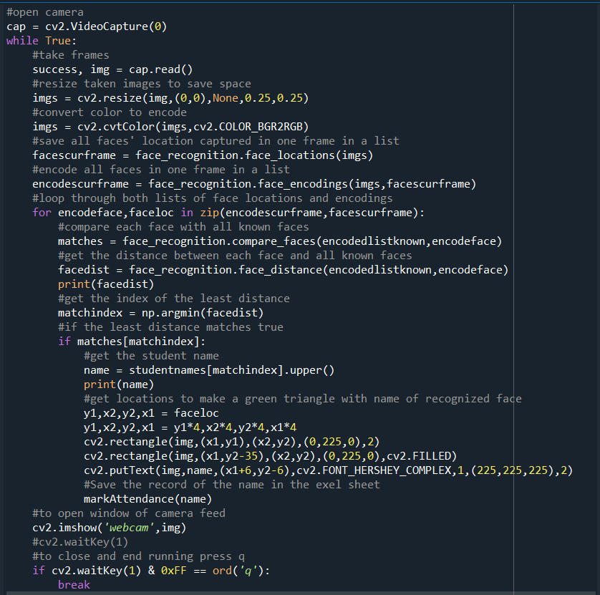
Code documentation
Capturing frames , Detecting faces , encoding these faces, matching them with encodings of known faces in the system.

Slide 16
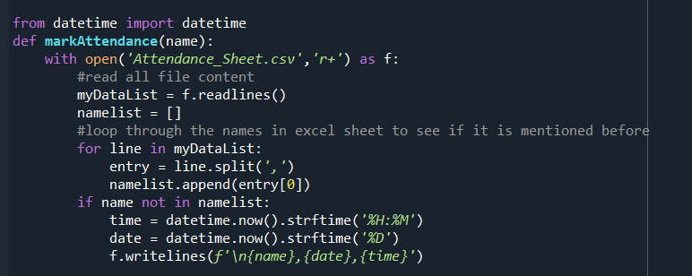
Code documentation
Saving names of students with the time and date of recognition into the attendance excel sheet

Slide 17
Thank You

